Slide 1
THE MYSTERIOUS ISLAND ADVENTURE A TEXT-BASED SURVIVAL QUEST

Slide 2
The Main Theme Of The Game
You wake up on the shore of an uncharted island. The sun blazes overhead, waves crash nearby, and strange sounds echo from the dense jungle behind you. You have no memory of how you got here; you only feel that you’re not alone.
The island is full of mystery. Whispering winds share tales of ancient civilizations, hidden temples, and treasures buried deep beneath volcanic rock. But it’s not just secrets that dwell here; danger lurks around every corner.

Slide 3
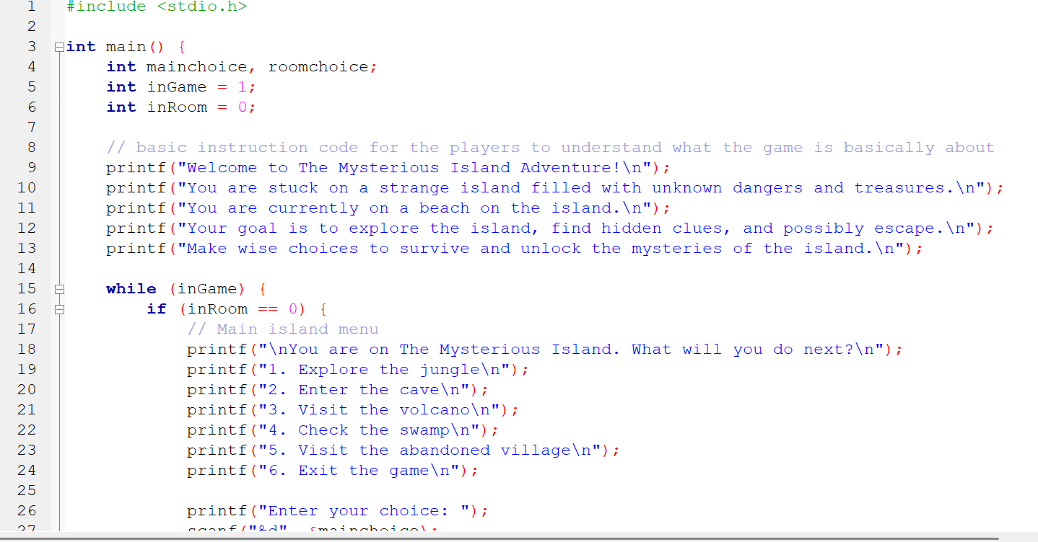
Code Of The Game :

Slide 4
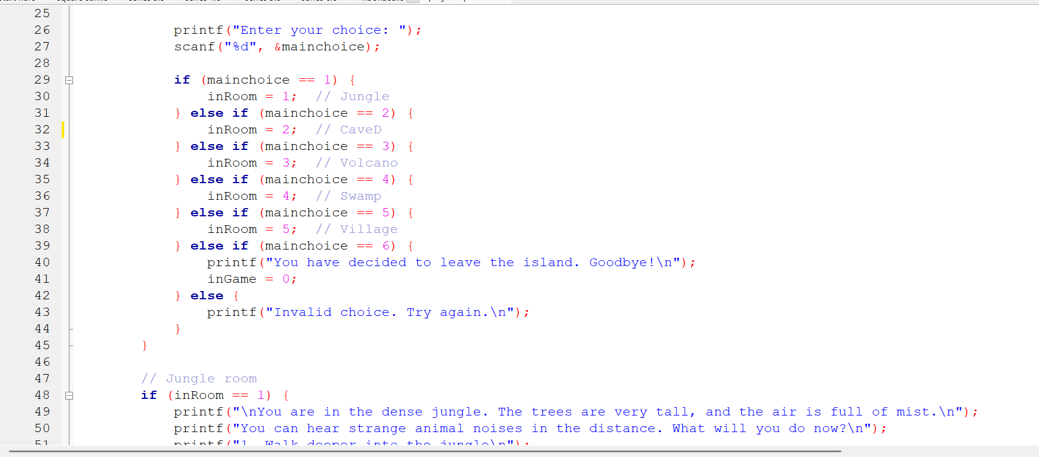

Slide 5
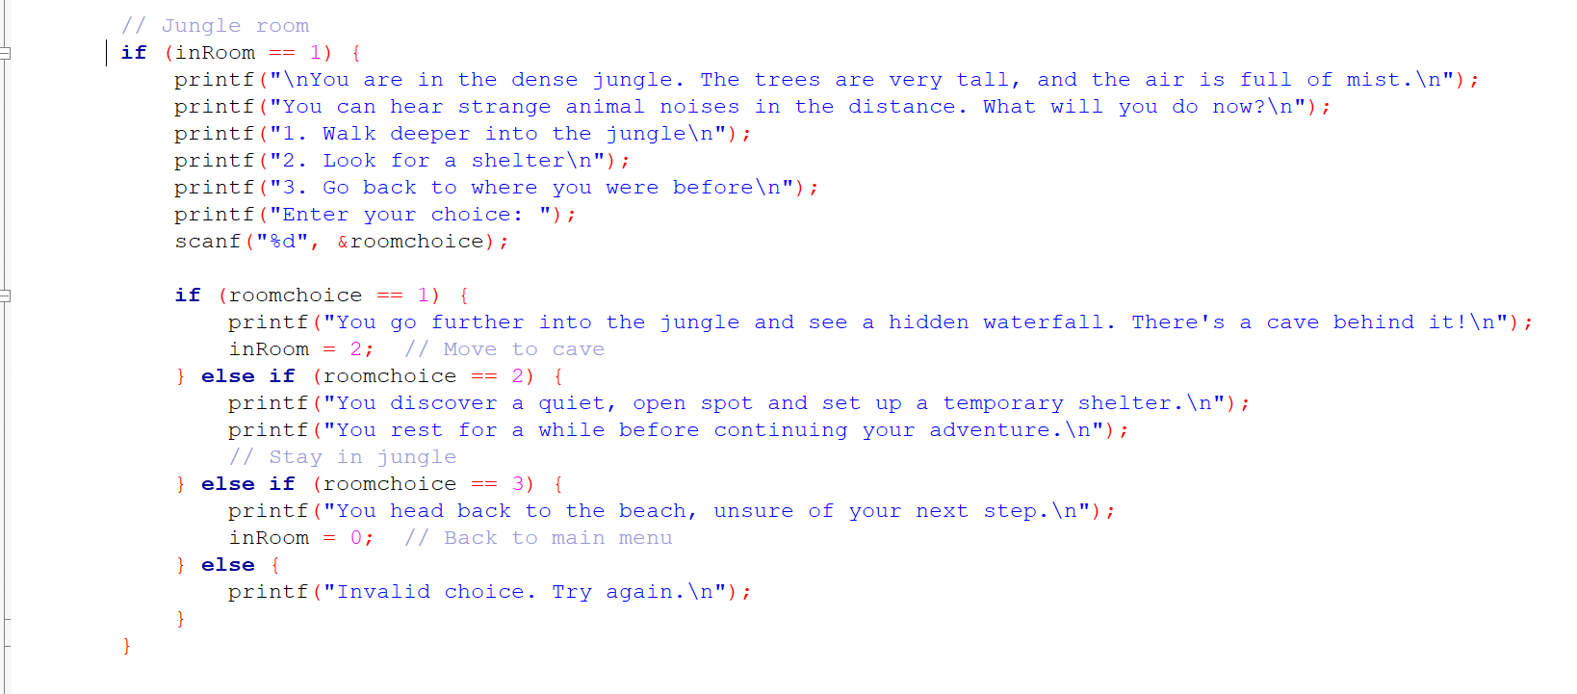

Slide 6
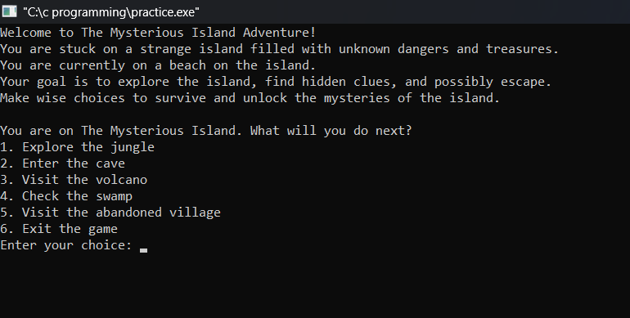
Starting Interface Of The Game:

Slide 7
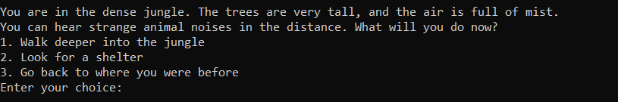
If You Choose 1:

Slide 8
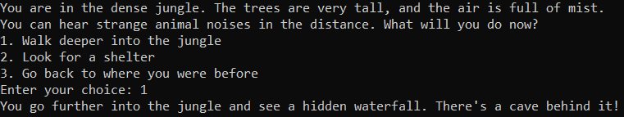
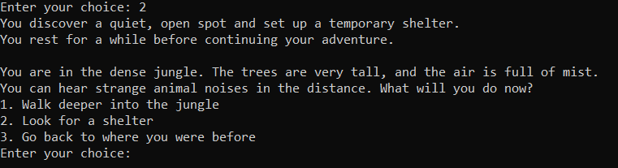
After Entering In The Jungle:
If you choose 1:
If you choose 2:

Slide 9
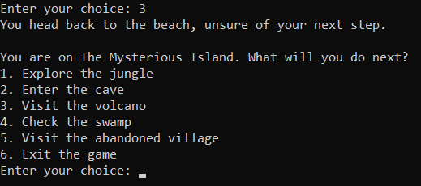
If you choose 3 :

Slide 10
That’s it for today!
We’re working on it…

Slide 11
THANK YOU

